Slide 1


Digital Innovative Solution for Plastic Bottles Free Landfill
Dr. Swami Subramanian
Swaminathan.subramanian@mail.analytics.hbs.edu

Slide 2
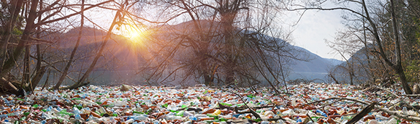
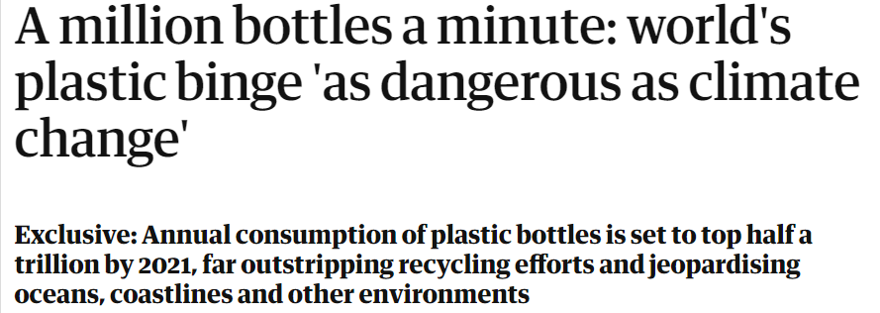
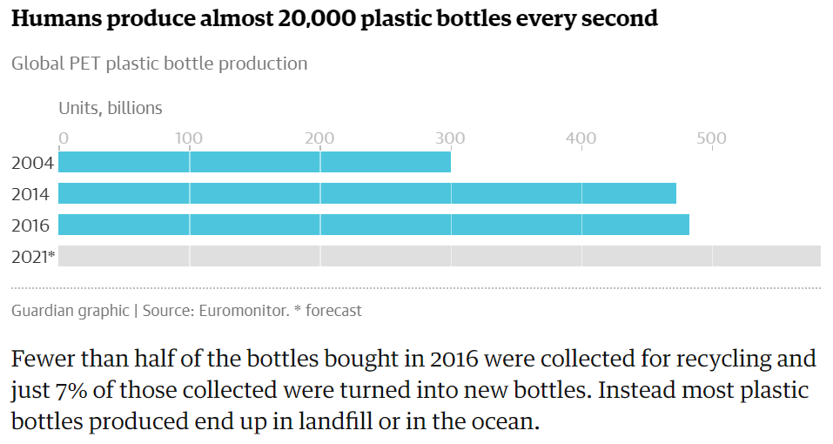
Problem Statement
Only 20% of plastic bottles are recycled. The rest end up in landfills or in the ocean at a rate of 1500 bottles/second.
700 years to start decomposing.
Around 90% of the cost of bottled water is spent on packaging.
Plastic bottle chemical components (Antimony, Bisphenol A , phthalates) are very harmful to health and the environment.

Slide 3
Solutions
Avoid Plastic – Unrealistic / Impractical
Recycle – So difficult to do it (20% is the maximum possible with current approach)
So what we can do it?
Technology Embedded Solution that Enforce the Orderliness (Recycling)

Slide 4
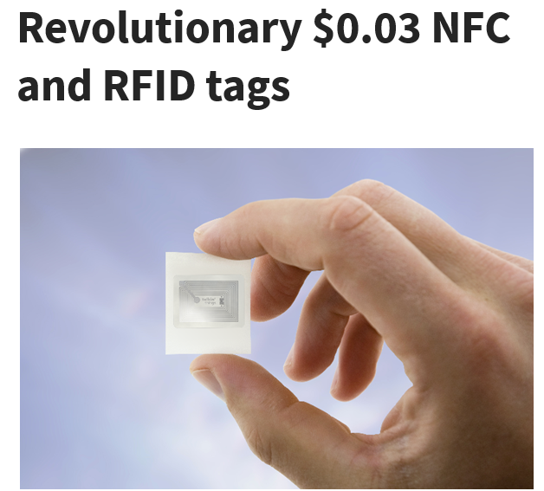
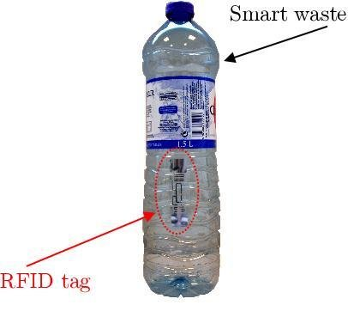
Digital Technology for Regulation
This is already there…so the question pops “what is your solution?”
https://rfid.talkinthings.com/rfid-revolution
August 2020

Slide 5
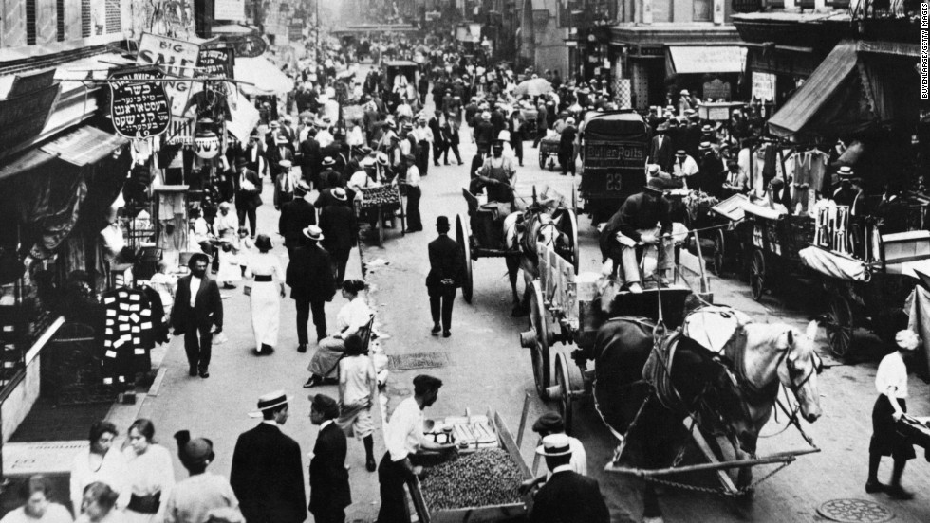
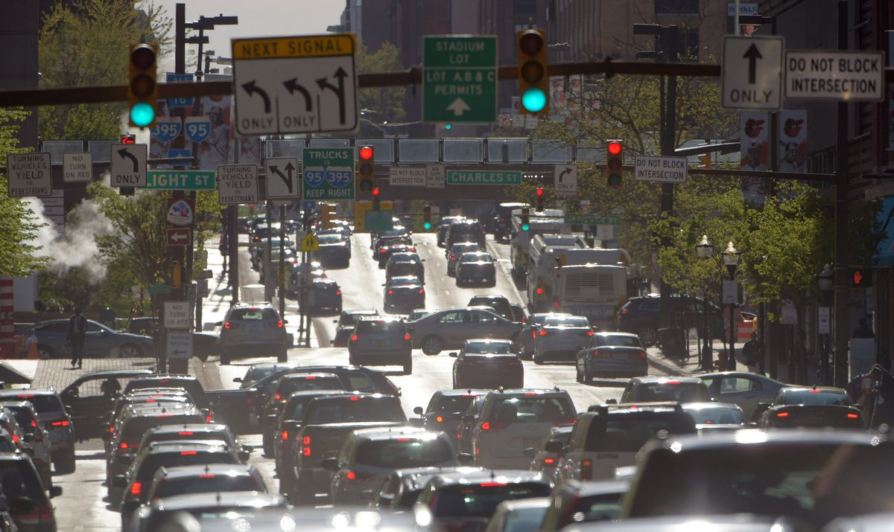
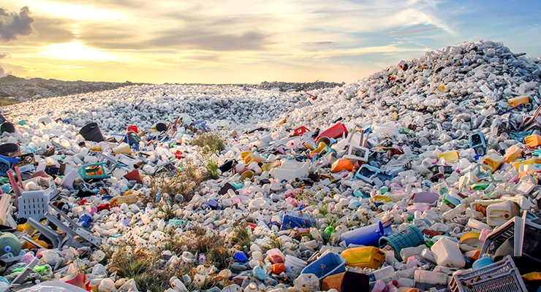
?
Regulated
Un-Regulated

Slide 6
Enforced Regulation and Track it through a Digital Platform
Very similar to the traffic light analogy → fewer cars, we didn’t need any traffic lights. But at an increased traffic the solution (traffic light) came and regulated (Pay penalty) the users (Since 1914, the first traffic signal in the USA)
Rule here for plastic bottle
  Each and everyone who buys the plastic bottle is responsible for routing it to the recycling station !!?!?!?!??!?!
  Is it possible?
  Yes, a digital platform help resolve
How?

Slide 7
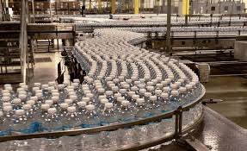
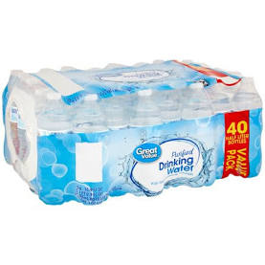
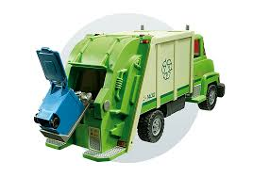
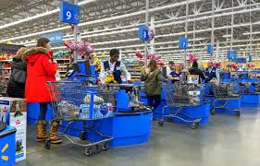
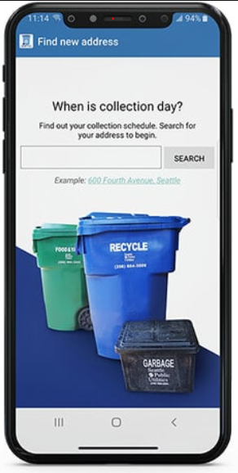
How it Works?
RFID embedded
Packaging Slip
App/Digital platform track the buyers and their bottles
Recycling Truck with UHF RFID readers – To tally the account for buyers

Slide 8
Value Creation & Value Capture
Value Creation
Everyone in the Earth (Free from cancer and other diseases)
Plastic Bottle Manufacturers (Branding/Recycling reduces the raw material cost)
Governments (Plastic free landfill)
Buyer (incentives from recycling)
Digital Platform
Value Capture
Governments (Platform service cost)
  Everyone in the Earth (Pay penalty if not recycled in a year)
Everyone need to register through the app – get the incentives if they recycle it or pay penalties
Plastic Bottle Manufacturers need to add RFID tag
Government track it and charge the buyer if they haven’t recycled it
Buyer used to scan the bottle/package during the purchase (Accountability)
UHF RFID readers need to be installed in waste management – recycling pickup trucks

Slide 9
Regulation and Monitoring System are Critical to Save the Earth from Plastic Landfills

