Slide 1

Right on TIME
Presented by
Taposhi Bentley, CPA
June 1, 2020

Slide 2
Who is MB&F?
MB&F was founded by Maximillian Busser, a Swiss Entrepreneur of the avant garde boutique watch brand. Prior to MB&F, he was the CEO of Harry Winston, Inc. As you can imagine Harry Winston is a brand synonymous with ultimate luxury and epitome of style among the rich and famous.

Slide 3
Who is MB&F?
MB&F time pieces are works of art and are sold at high end jewelry retailers in the United States and around the world. These are one of a kind time pieces (watches) that retail for $120,000 US and more.

Slide 4
Who is MB&F?
Maximillian known as Max Busser has a love for all things elegant and mechanical founded the M.A.D Gallery. Max’s galleries combine his background in engineering with design to house art pieces. M.A.D stands for mechanical art devices.

Slide 5
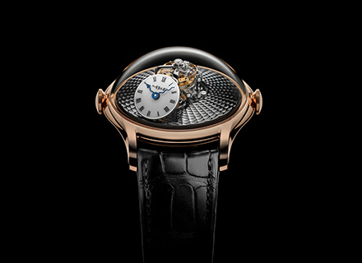

Slide 6
Business Proposal
I first read of Max Busser in Forbes magazine article dated June 16, 2016. I kept this article on my desk for 4 years, never really finding the time to follow up. Two weeks ago, I finally reached out to him – making an invitation to visit Chicago for a personal appearance to continue to build his presence in the United States.

Slide 7
Business Proposal
After corresponding via email, he agreed to discuss a potential visit to Chicago in 2021. Among time piece collectors MB&F is well known. Many Chicago high end jewelry retailers already carry his one of a kind time pieces. However, many still are not familiar with the MB&F brand.

Slide 8
Market Size
49% of MB&F sales are derived from the Asian market. Max has a M.A.D gallery in Taipei and another in Dubai, United Arab Emirates. Cellini Jewelers in New York has hosted Max for the past four years. He also has jewelers that host him in the West Palm Beach area.

Slide 9
Market Size
In Chicago, we would also like to host a special reception for Max Busser, founder of the MB&F brand. Our plan is to introduce his brand to the automotive & yacht industry of the Midwest as well as specialty high end jewelers.

Slide 10
Market Size
Once we have received a final confirmation of acceptance, we will begin to reach out to our business contacts. Our proposal to Max is showcase his time pieces alongside exotic cars either at retail level but more preferably at the Chicago / Detroit automobile show 2021.

Slide 11
Upfront investment & Recovery of Capital
As Max’s spokesperson in Chicago, I will invest the time to send targeted proposals. Max can collaborate on the message to the target audience. Max will be responsible for his own airfare, however, we will sponsor all costs associated with his week long stay in Chicago.

Slide 12
Upfront investment & Recovery of Capital
Our goal is to sell several time pieces in Chicago. Part of the proceeds from the sale would be to recover the initial investment in time/resources spent but also raise funds for Dharma Foundation.

Slide 13
Upfront investment & Recovery of Capital
Part of the proceeds from the sale would go to Dharma Foundation to help underwrite the St. Paul Cathedral orphanage for Boys and Girls in Kolkata, India as well as the numerous charities it supports in the United States. As Founder of Dharma Foundation I am very particular in how Dharma Foundation is perceived in the public as we will be celebrating our 20 years in 2021. Over the past 20 years Dharma Foundation has assisted over 150 charities including 3 authors.

Slide 14
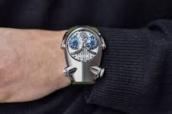
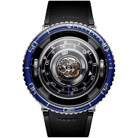
Next Steps
Have the Advisors at Harvard University review and critique the proposal
Discuss next steps with Max Busser
Sign confidentiality agreement
Decide on percentage for Dharma Foundation based on sales
Get media/press kits from MB&F
Send proposal to showcase these masterpieces at Chicago’s auto show
Send proposal to host reception at high end jeweler
Establish budget for cocktail reception, travel and accommodations
Plan and execute events
Work with sponsors to gain media presences

Slide 15
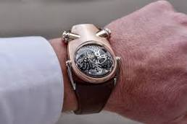
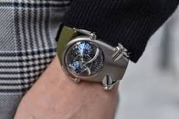

Slide 16
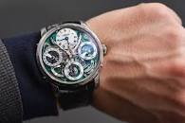

Slide 17
Graphics are copywritten by
MB&F

