Slide 1
An emerging market community innovation platform proposal
HBAP June 2020 Immersion Pitch Competition proposal developed by Charles Carter – all rights reserved
May 31, 2020

Slide 2
Contents
Problem Statements A to C
The Market Failure
Proposed Solution
Value Proposition
Implementation Plan
References
This proposal has been developed by Charles Carter, in collaboration with Colin Kinghorn (a final year Engineering student at the University of the Witwatersrand, Johannesburg, South Africa) who conducted a literature review and helped develop the initial proof of concept as part of a vacation assignment sponsored by Charles Carter. The contents of this document are work in progress and are shared with the HBAP community in confidence.

Slide 3
Problem statement (a) the African NGO model needs innovation
Africa is a continent rich in resources, innovation and opportunity, yet the majority of NGO projects are dependent on foreign aid to survive.
Value leakage is significant – at worst an estimated 75% of money collected by aid agencies is spent on administration of their own organization. Analysis of effective spend is also limited – over 70% of NGOs surveyed spend less than 5% of annual income on evaluation of outcomes (Morariu, 2012).
With the majority of aid funneled through local and foreign NGO’s, the ability of African communities to access funds and implement their own solutions is limited. Many large NGOs
and CSI programs also often operate in isolation to one another, resulting in a lack of transparency and coordination both to innovate and address pressing social needs in a cost-effective and scalable manner.

Slide 4
Problem statement
(b)
Africa is enjoying a rapidly evolving digital infrastructure
Digital access is rapidly changing the Africa opportunity set. In 2019 approx. 525 million people in Africa accessed the internet, compared to 448 million in Latin America and 327 million in North America. 74% of web traffic in Africa in 2019 was generated via smartphones, showing the importance of developing less data intensive, mobile solutions (Silver, 2018).
Three of Africa’s largest economies (South Africa, Nigeria and Kenya) generated a combined $9.6 billion in e-commerce sales in 2019, with an average annual e-commerce revenue growth rate of 38% and an e-commerce user growth rate of 16%. Importantly, an average of 34% of e-commerce revenues in these three economies came from the low-income segment – driven by the adoption of smartphones, cheaper data and innovative payment technologies (McKinsey & Co, 2019).
‘Mobile Money’ has driven financial inclusivity – 21% of adults in Sub-Saharan Africa use mobile money accounts to shop online, transfer funds and pay for basic services. In 2018, $26.8 billion in ‘mobile money’ was transferred in Sub-Saharan Africa, accounting for 46% of global ‘mobile money’ activity (Jalakasi, 2019).

Slide 5
Problem statement
(c) the African vc funding model is relatively new and faces challenges
In 2017, only $195 million in VC funding was raised by African tech startups, almost all of which was raised in South Africa, Nigeria and Kenya. This compares to the $84 billion in tech startup funding raised in the US over the same period (Moed, 2018).
African SMEs are struggling to raise capital, particularly in low income areas where business investment is most needed, yet over 60% of total GDP in Sub-Saharan Africa is generated by SMEs. (IFC, 2019).
Existing crowdfunding models typically set a goal value and have an “all or nothing” funding character while also typically raising small amounts of money – in Africa where VC funding is scarce, the ask is everything from small projects to sizeable community interventions that more typically meet NGO or CSI funding criteria.
The World Bank projects that the global crowdfunding market will reach $90 billion annually by 2025 – roughly 1.8x the size of the global venture capital industry (Chattopadhyay, 2017).

Slide 6
So what’s the market failure?
There are no scalable, cost-effective open innovation digital platforms in Africa that facilitate the identification of social needs, encourage direct community participation, draw on crowd and institutional expertise to problem-solve and act as a transparent bridge between communities, NGOs, the private and public sector, to fund and implement sustainable innovation on the ground.
Traditional crowdfunding pipeline models are ill-equipped for Africa because:
They are “short” – taking projects to early stage funding only.
They are “narrow” – restricting project owners from withdrawing vital bootstrap capital until a specific goal is reached and typically discourage stakeholder participation outside of project promoters.
They “leak” – no value is provided for the majority of project proposals that do not reach required targets.
They are not transparent – you cannot track project progress from the outside and collaboration by external stakeholders is seldom a consideration.
They are profit-driven enablers that do not typically enjoy multi-stakeholder support.

Slide 7

Proposed solution a not-for-profit social engagement platform that funds innovation transparently
Private Sector
Public Sector
More data
publicly accessible
Entrepreneurs
More usage
Better algorithms
Community members
Better engagement
Experts from local Universities
NGOs
Adapted from Iansiti M & Lakhani KR, Competing in the Age of AI, HBR Press, 2020

Slide 8
A crowdfunding platform pipeline that’s long, wide and transparent
Notes:
Consider talking about:
Government driven
Product platforming
Idea competitions
Customer immersion
Collaborative product design and development
Innovation networks
In science
Innovation intermediaries

Slide 9
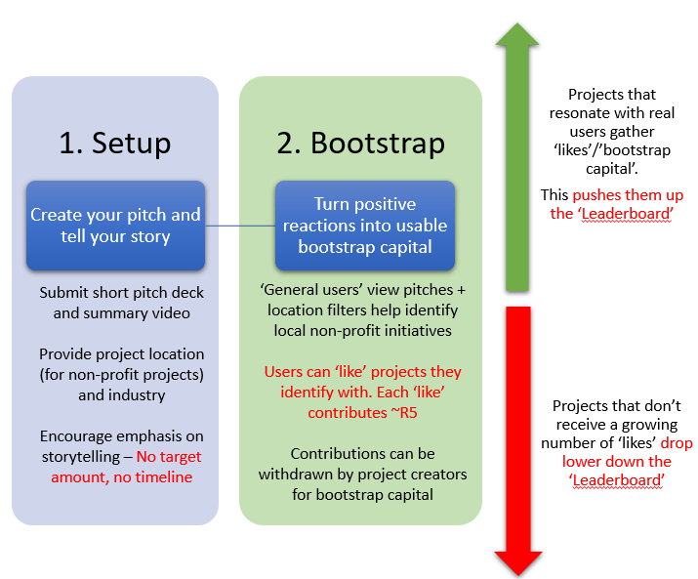
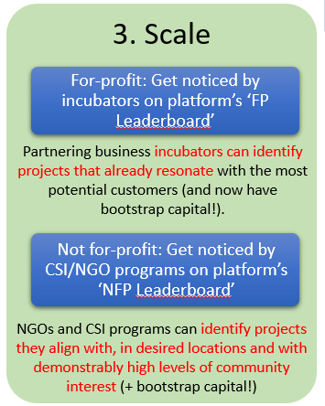

The leaderboard public ranking concept
Location and industry filters allow ‘likes’ from industry experts and local universities and those geographically close to the project to be weighted more heavily
Leaderboard

Slide 10
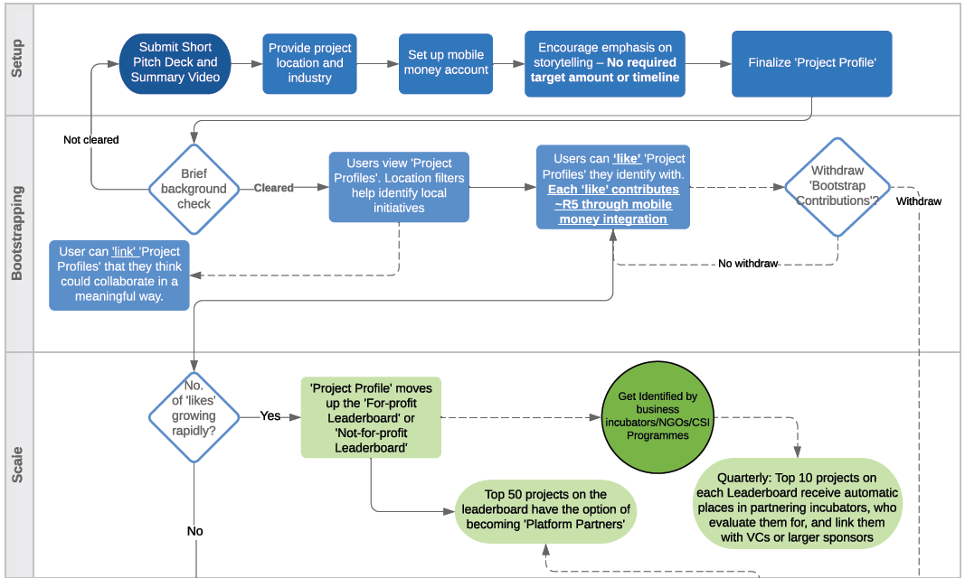
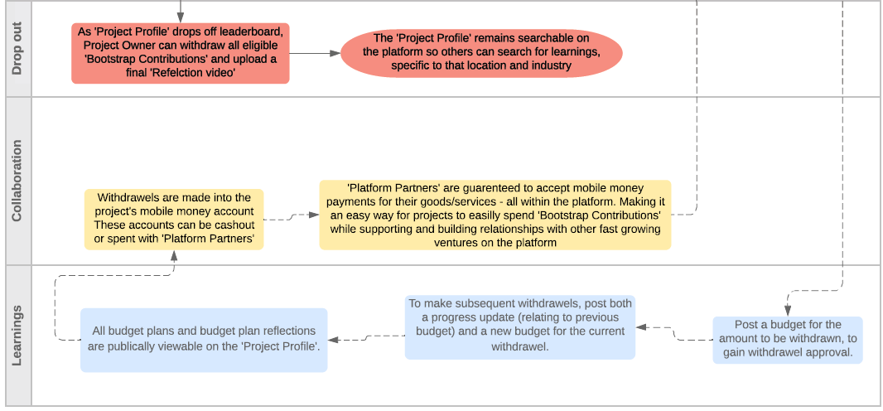
Flow chart of concept in action

Slide 11
What’s in it for each key stakeholder?
The Entrepeneur
  Gain initial seed funding and project visibility via a ‘bootstrapping ‘ approach, gain knowledge from a transparent process, know why proposal succeeds or fails – if successful move beyond platform to VC or other funding
The Community
  Participate directly in reviewing and ranking local projects of interest – over time see tangible outcomes; win prizes for participating in leader board ranking, e.g., data bundle sponsored by local cell phone provider
The NGO
  Understand community interests and opportunities cost-effectively, access complementary public/private partnership opportunities with opportunity to partner on individual projects of interest
Private Sector
  Sponsor projects that have visible community support and draw on expertise of the crowd to innovate – can sponsor on the platform or beyond the platform
Public Sector
  Opportunity to partner on local projects of interest and improve public/private partnerships; gain visibility to innovation opportunities in areas of interest
Local Universities & Subject Experts
  Offer expertise to projects and build partnerships that leverage institutional areas of research and innovation
The Platform
  Facilitate innovation, build domain expertise, capture data and offer open-sourced cost-effective innovation outcomes – over time identify opportunities to self-fund platform costs (e.g. advertising, nominal royalty on successful entrepreneur ventures)

Slide 12
Implementation plan
Further develop concept proposal post HBAP engagement with focus on narrowing the problem and deepening the platform architecture
Develop desk-top platform prototype and work up matching components, costing and indicative build timeline
Test concept with select stakeholders in South Africa (an NGO, potential corporate sponsor, community interest groups, local university and other expert participants)
Refine concept, platform prototype and associated components
Raise start-up funding, likely from philanthropic foundations, and build a project team
Get a working prototype up and running and test in one select community with a targeted entrepreneur, aligned corporate sponsor and select NGO and university participation
Fine-tune platform and resolve teething problems
Undertake incremental rollout and build platform visibility and associated stakeholder buy-in by geography and/or issue specific ventures
Build stakeholder network, promote community visibility, improve platform functionality and promotional ways to enhance matching effect
Keep learning, keep refining and navigate the unexpected …

Slide 13
references

